Slide 1





Curriculum and Course Design for Mechatronics and Robotics Engineering Education

Slide 2
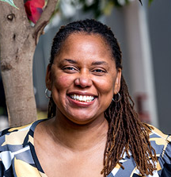

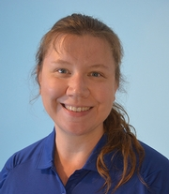
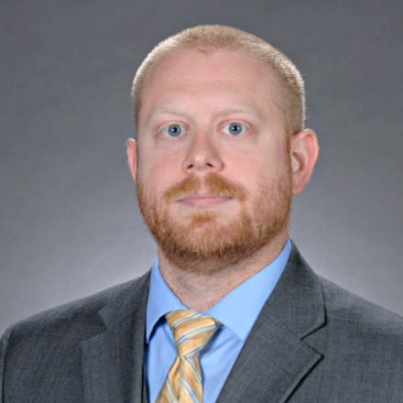
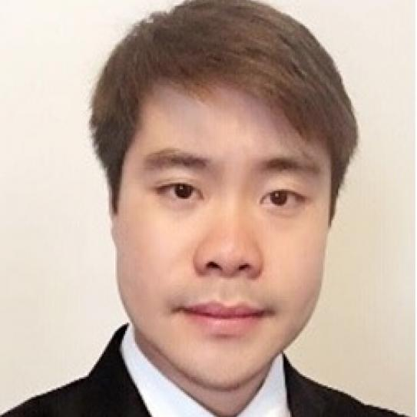
Introductions
Carlotta Berry (RHIT)
Greg Lewin (WPI)
Melissa Morris (ERAU)
James Mynderse (LTU)
Ray Li (NYU)

Slide 3
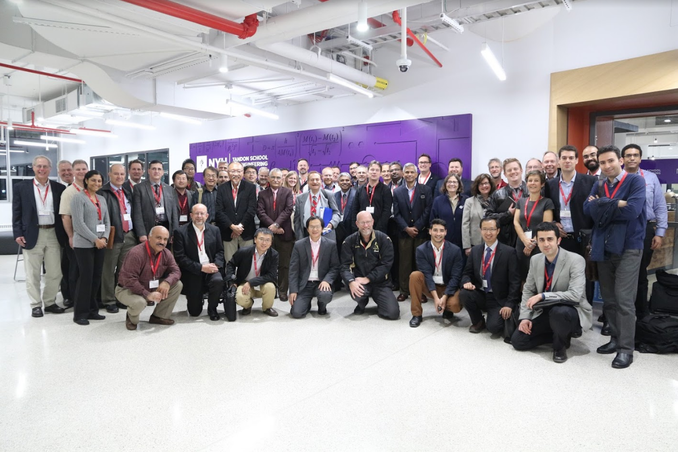
This group started at Vikram Kapila’s Mechatronics Education Innovation Workshop (NYU Tandon, Nov. 2016)
Future of Mechatronics
Key components of programs
Role of the industry
Programs reflecting industry
Technical skills need in industry
Burden on faculty
Notes:
Talk about the online community

Slide 4
Our Future of Mechatronics and Robotics Engineering (FoMRE) Vision
MRE will become one of the most impactful disciplines of engineering by
Attracting diverse & innovative students who will
Graduate into professional engineers destined to
Design, develop, & implement transformative autonomous technologies that
Improve human health, safety, & welfare.

Slide 5
Long-term Goals
Develop a diverse, inclusive community of MRE educators, students, & practitioners
Define the MRE knowledgebase
Achieve recognition of MRE as a distinct engineering discipline
Accelerate adoption of MRE courses & curricula
Approach:
Conduct workshops in technical conferences (ASEE 2019, DSCC 2019, RSE 2019)
Conduct standalone workshops (LTU 2019, WPI 2022)
Webinar series
Financial Support
National Science Foundation
Quanser

Slide 6
Initial workshop results
ASEE 2019, DSCC 2019, RSE 2019 – half-day workshops
Travel support for some attendees
Discussion on multiple topics
LTU 2019 – standalone workshop
Travel support for attendees
Day 1 – Industry & Academia
Day 2 – Academia
6 Working groups formed

Slide 7
Initial workshop results
67 participants provided survey responses
Current faculty, future faculty, and industry professionals
26% female
31% non-white
Participant survey results
97% agreed that their knowledge of MRE education increased
92% agreed that their confidence as MRE educators increased
80% agreed that they were better prepared to teach MRE concepts
94% agreed that a community of MRE educators was developed
97% agreed that they felt a sense of belonging to the MRE community

Slide 8
WPI 2022 workshop results
Standalone online workshop with robot kits provided
Pololu Romi kit (see Greg Lewin)
1 or 10 robots per kit
Participants experienced sample lab experiments
WPI intro course
RHIT advanced course
Curriculum examples
Open-source hardware and software

Slide 9
WPI 2022 workshop results
35 registered participants
22 participants with 10 kits, 13 participants with 1 kit
46% female
60% non-white
Participant survey results
85% agreed that their knowledge of MRE education increased
84% agreed that they were better prepared to teach MRE concepts
95% agreed that they felt more connected to other MRE educators
95% agreed that they felt a sense of belonging to the MRE community

Slide 10
Preview of activities
Introduction
Approach to Curriculum (Carlotta & Greg)
Break
Virtual Robot Challenges (Carlotta & Melissa)
Break
Hardware Platform (Carlotta & Greg)
Future Plans / Feedback (James & Ray)

Slide 11
What do YOU want to get out of this workshop? What changes do YOU want to make at YOUR institution?
Think to yourself…
Share with your neighbor…
Share with the group!

